Slide 1
Homeostasis
Part 3: Life &Cell Transport

Slide 2
Topics covered
B11-1-06:Identify life processes that individual cells, as well as complex organisms, need to manage.
B11-1-07: Explain how cell membranes regulate the movement of materials into and out of cells, and recognize the importance of this regulation in managing life processes and maintaining homeostasis.
B11-1-08: Identify factors that influence movement of substances across a membrane, recognizing that movement of these substances is important for internal balance.
B11-1-09: Explain the role of energy in maintaining an internal balance in the cell.

Slide 3
Life processes

Slide 4
What does it mean to be alive?
What is the meaning of “alive”?
Brainstorm as a class
Google diction definition:
(of a person, animal, or plant) living, not dead; continuing in existence or use
(of a person or animal) alert and active; animated; having interest and meaning
Aware of and interested in; responsive to
Swarming or teeming with

Slide 5
Characteristics of being alive
Characteristic | Description
Acquire energy | Almost all energy comes from the sun. Green plants use photosynthesis. Energy is used for metabolism
Reproduce | Asexually – clones Sexually – two individuals combine genetic material – not clones
Grow and develop | With size increase, increase in number of cells or size of cell and repair of damaged cells
Respond to external stimuli | Respond to other animals, plants, respond to light changes, tolerance levels vary
Are organized | Molecules- macromolecules-membranes-cells-tissues-organs-organ systems-organism
Maintain homeostasis | Organisms must maintain internal equilibrium

Slide 6
Regulation at a cellular level
The cell membrane is responsible for maintaining the balance of substances inside a living cell.
Membranes have different methods to transport different molecules into and out of the cell.
Why is this important? A cell cannot tolerate any great variation in conditions.
Too much water can burst a cell.
Too many wastes inside a cell can poison it.

Slide 7
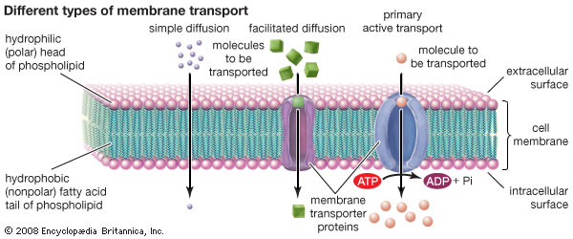

Slide 8
Cell Transport

Slide 9
Three methods of transport
Passive Transport (“Facilitated Diffusion”)
-movement of particles across the cell membrane that does not require any energy input.
Active Transport
- movement of particles across the cell membrane that does require any energy input.
Endocytosis/Exocytosis
-the process in which a cell engulfs or expels large particles by extending their cytoplasm around the particle
Notes:
Endo/exocytosis is a type of active transport (uses energy)

Slide 10
Passive Transport
Water will always move from an are of high concentration to an area of low concentration
Types:
Diffusion:
Movement of molecules from an area of high concentration to an area of lower concentration
Osmosis:
The diffusion of water through a selectively permeable membrane

Slide 11
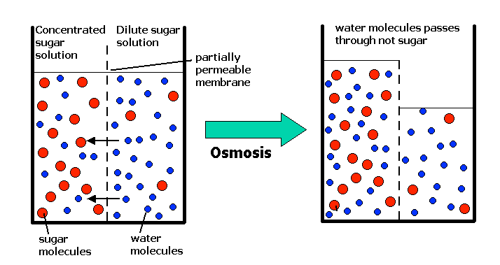

Slide 12
Passive transport and tonicity
Tonicity:
The state of a solution in respect of osmotic pressure
3 different terms:
Isotonic
- A solution in which solution concentration outside the cell is equal to that inside the cell
Hypertonic
-a solution outside a cell that has a higher concentration of solutes compared to that inside the cell
Hypotonic
-a solution outside a cell that has a lower concentration of solutions compared to that inside the cell

Slide 13
Isotonic
The movement of water into and out of living cells is vital to life processes
Water moving into cells is balanced by water moving out of cells. This is called equilibrium.
Equilibrium happens when a cell is in an isotonic solution
This is the usual state of most cells.

Slide 14
Hypertonic
There is no equilibrium if a cell is placed in a hypertonic solution.
Water will move out of the cell, causing the cell to shrink
(Water is moving to the place with more solutes, which is outside the cell)
Water will continue to move until an equilibrium is reached

Slide 15
hypotonic
There is no equilibrium if a cell is placed in a hypotonic solution.
Water will move into the cell, causing the cell to expand
Cells have a possibility of bursting
(Water is moving to the place with more solutes, which is inside the cell)
Water will continue to move until an equilibrium is reached

Slide 16
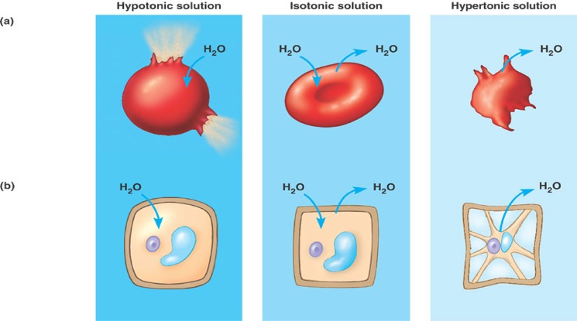
Notes:
Describe difference between animal and plant cell….highlight cell wall

Slide 17
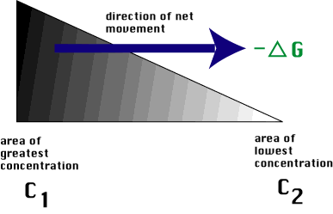
Passive Transport Cont’d
Concentration Gradient
When one side of the membrane has a higher concentration of solutes than the other

Slide 18
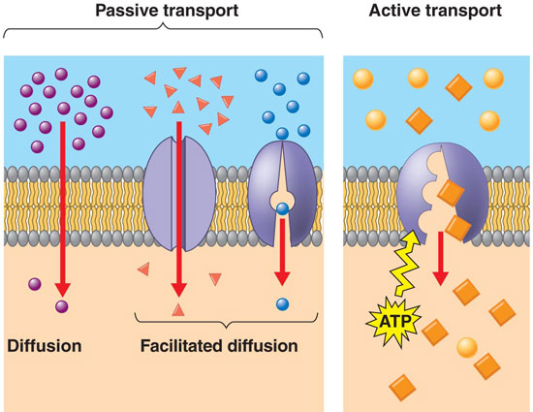
Passive Transport Cont’d
Facilitated diffusion
Protein carrier molecule, located in the cell membrane can aid in passive transport

Slide 19
Passive Transport Cont’d
Factors that influence passive transport:
Temperature
Molecules with more heat energy move more quickly across a semi-permeable membrane
Surface area
Passive transport happens at the surface of membranes, so the greater the surface area the quicker the molecules can move across the membrane

Slide 20
Which molecules will diffuse in each of the figures below?
1
2
3
4
5
6

Slide 21
Active Transport
While you sleep approximately 35% of your total energy budget is used for active transport
Carrier proteins molecules suspended within the cell membrane receive an energy boost that permits them to aid active transport
The proteins use energy in the form of adenosine triphosphate (ATP) to capture specific molecules and move them into or out of the cell

Slide 23
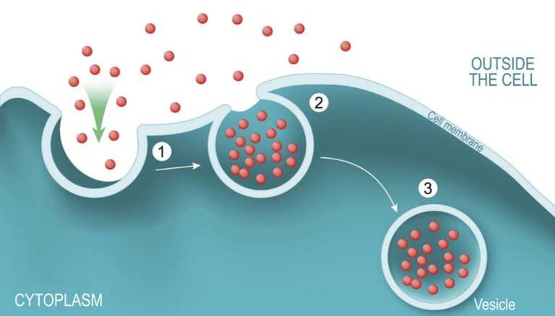
Endocytosis
Allows cells to take in (or engulf) larger particles that transport proteins cannot handle
The cytoplasm (and cell membrane) reach out to surround the particle

Slide 24
Endocytosis cont’d
There are 2 types
Pinocytosis
-cells absorb liquid droplets by engulfing them
-ex. Fat droplets in small intestine
Phagocytosis
-process by which cells engulf solids
-ex. Phagocytes
Notes:
Pinocytosis = cell drinking
Phagocytosis = cell eating

Slide 25
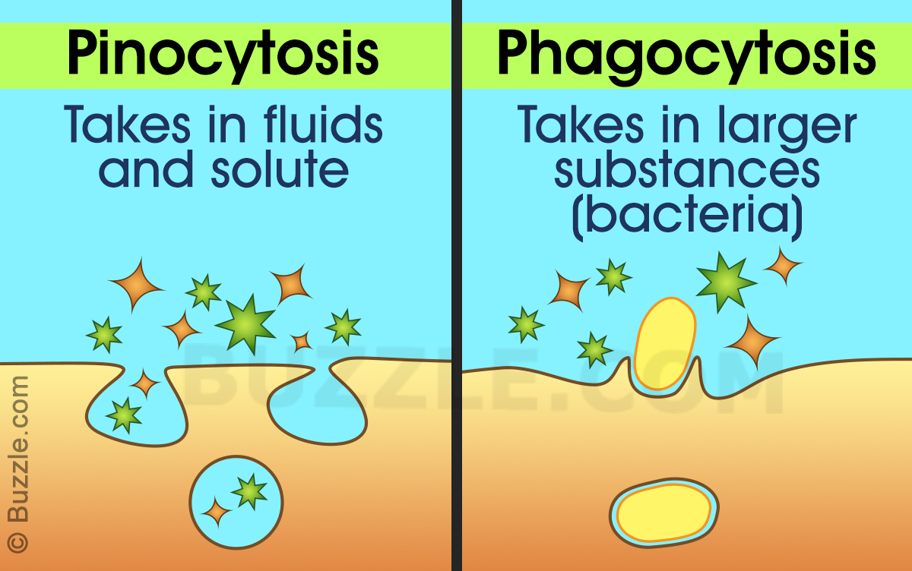

Slide 26
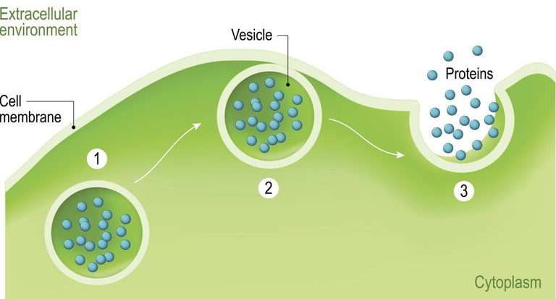
exocytosis
Allows a cell to transport large molecules out of the cell membrane.

