Slide 1
Urine as a Diagnostic Tool Lab
Grade 11 Biology

Slide 2
Patient 1: Martin Manoogie
Patient 2: Urethra Franklin
Patient 3: Roshanda Kim
Patient 4: Enzo Marin
Patient 5: Lori Grimes

Slide 3
Patient 1: Martin Manoogie
Protein Test
Sugar Test
Ketone Test
HCG Test

Slide 4
Patient 2: Urethra Franklin
Sugar Test
Protein Test
Ketone Test
HCG Test

Slide 5
Patient 3: Roshanda Kim
Protein Test
Sugar Test
Ketone Test
HCG Test

Slide 6
Patient 4: Enzo Marin
Protein Test
Sugar Test
Ketone Test
HCG Test

Slide 7
Patient 5: Lori Grimes
Protein Test
Sugar Test
Ketone Test
HCG Test

Slide 8
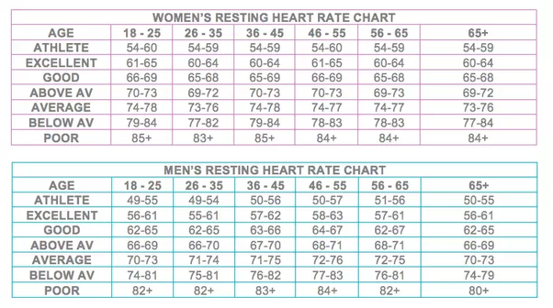
Normal Temperature: 98.6°F (36.7°C)
Normal Pulse:
Normal Blood Pressure: around 120/80

Slide 9
Rubric for Discussion
 | Accomplished (3) | Proficient (2) | Developing (1)
CLAIM | Makes an accurate and complete claim, uses complete and grammatically correct sentences | Makes an accurate, but incomplete claim, or grammatically incorrect | Claim is not accurate, incomplete, or unintelligible
EVIDENCE | Provides appropriate and sufficient evidence to support claim by referencing specific data, observations, or text evidence (for readings) | Provides appropriate data but insufficient data, too general or lacking in details | Provides evidence but it is insufficient, inaccurate, no details
REASONING | Provides thorough reasoning that links evidence to the claim, references scientific principles that are relevant to claim | Provides reasoning that links evidence to the claim, lacks scientific principles | Does not provide reasoning, or reasoning does not link evidence.
Treatment | Evidence of research to provide a typical treatment plan aligned to the patient diagnosis | Treatment plan is included, but not thorough or does not fully address patient’s problem | Treatment is not is inaccurate or incomplete

